Slide 1
VetChat
“To help veterans around the world to seek help by learning that they are not alone.”

Slide 2
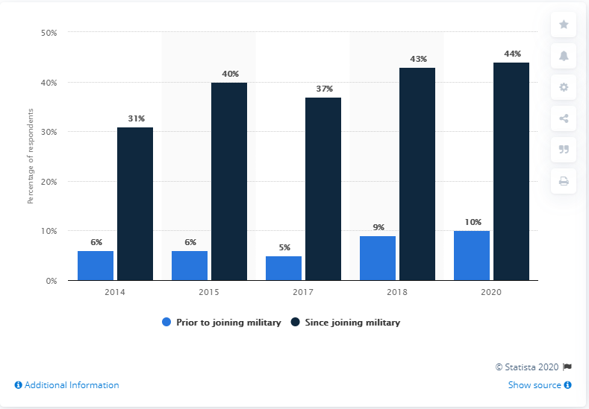
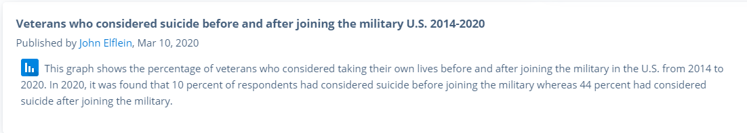

Slide 3
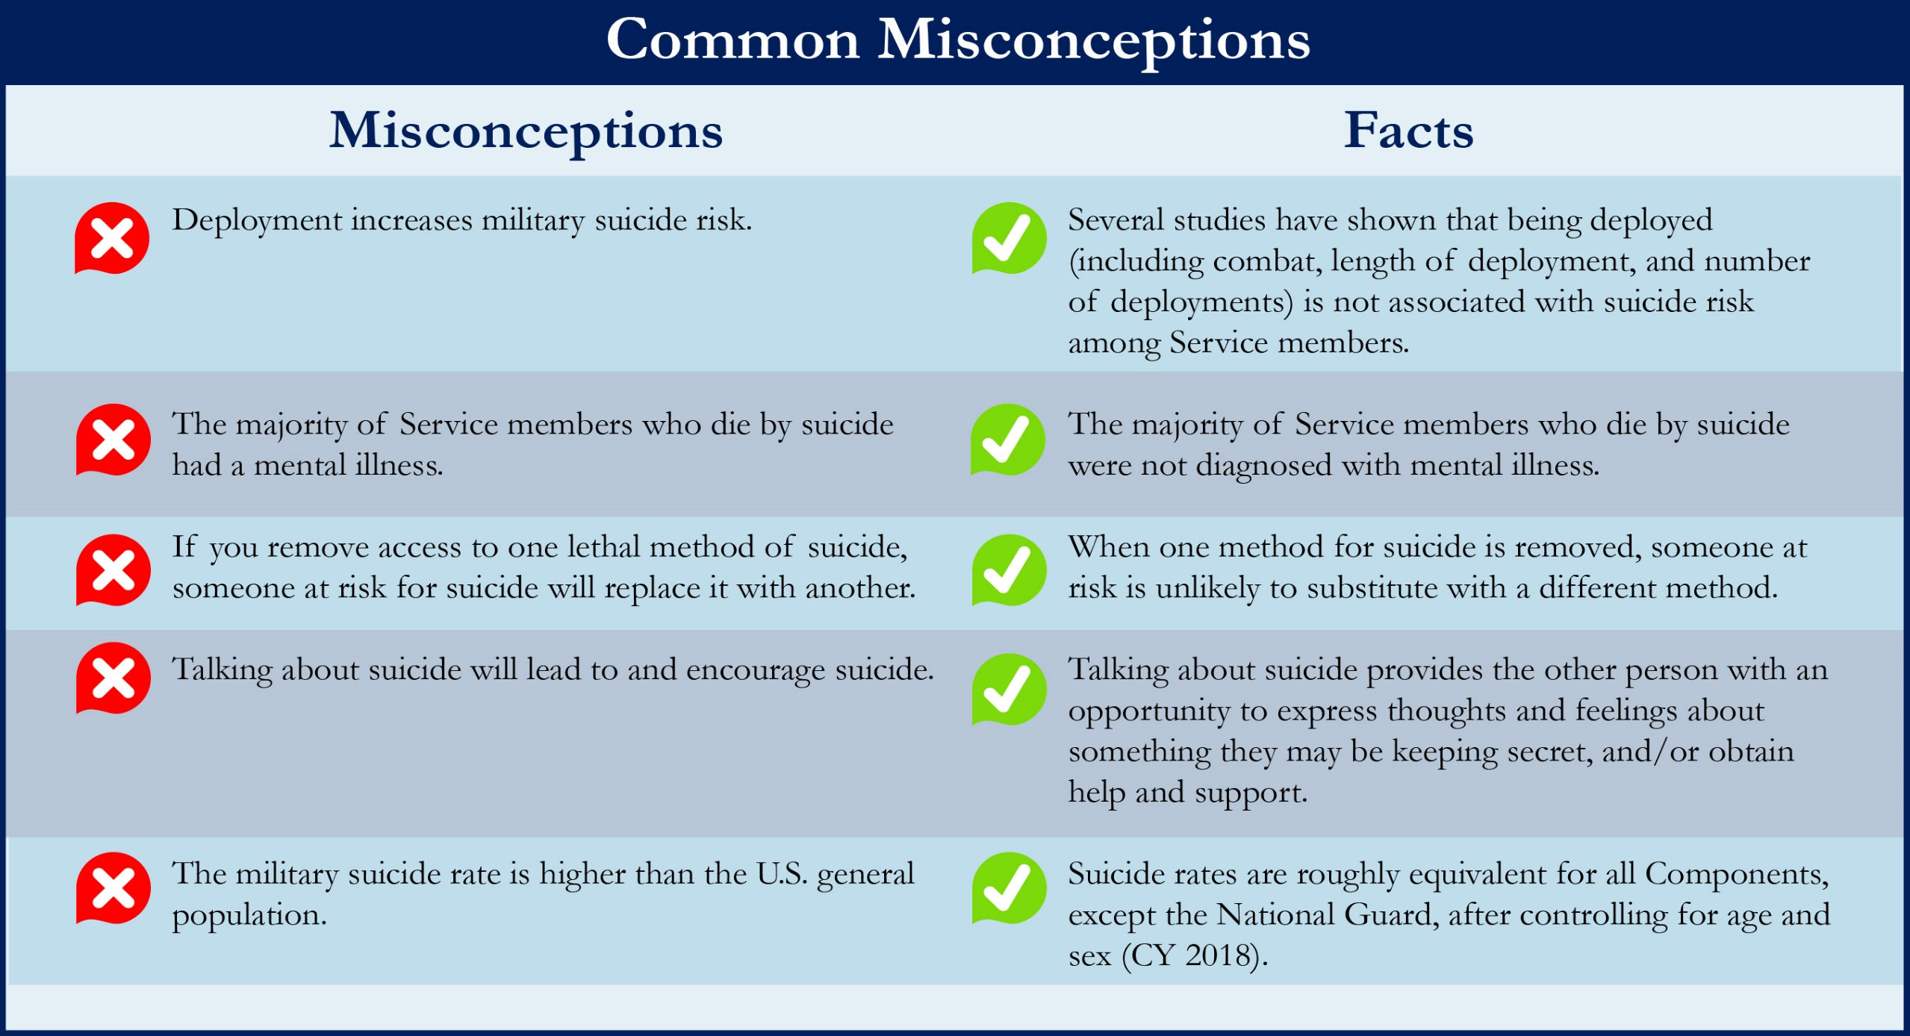

Slide 4
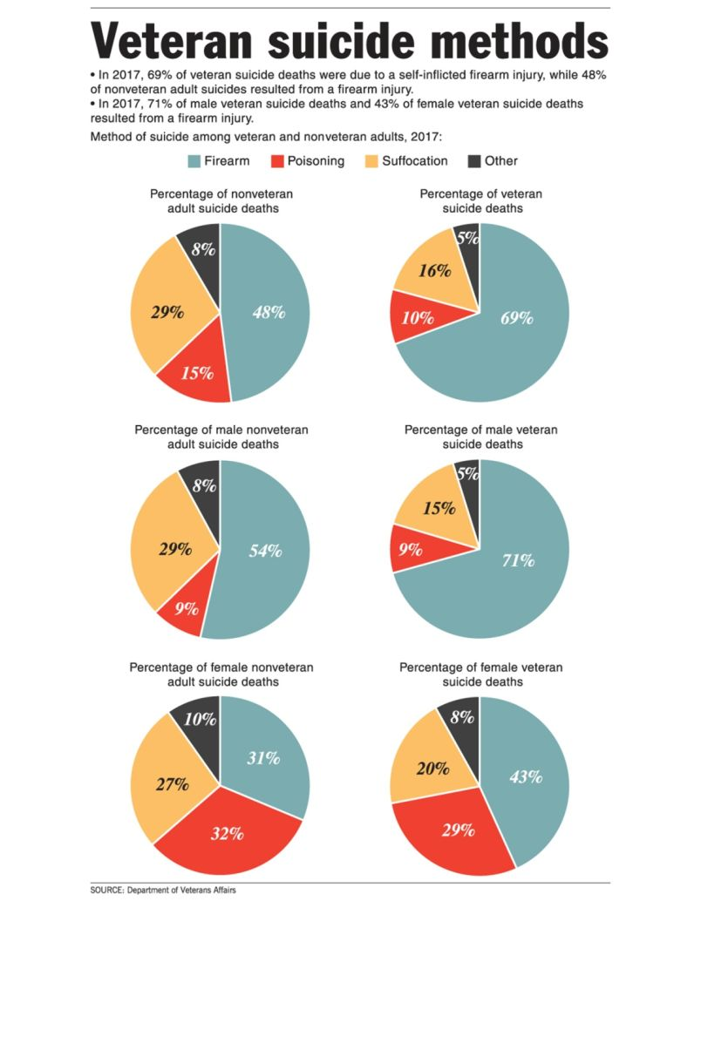

Slide 5
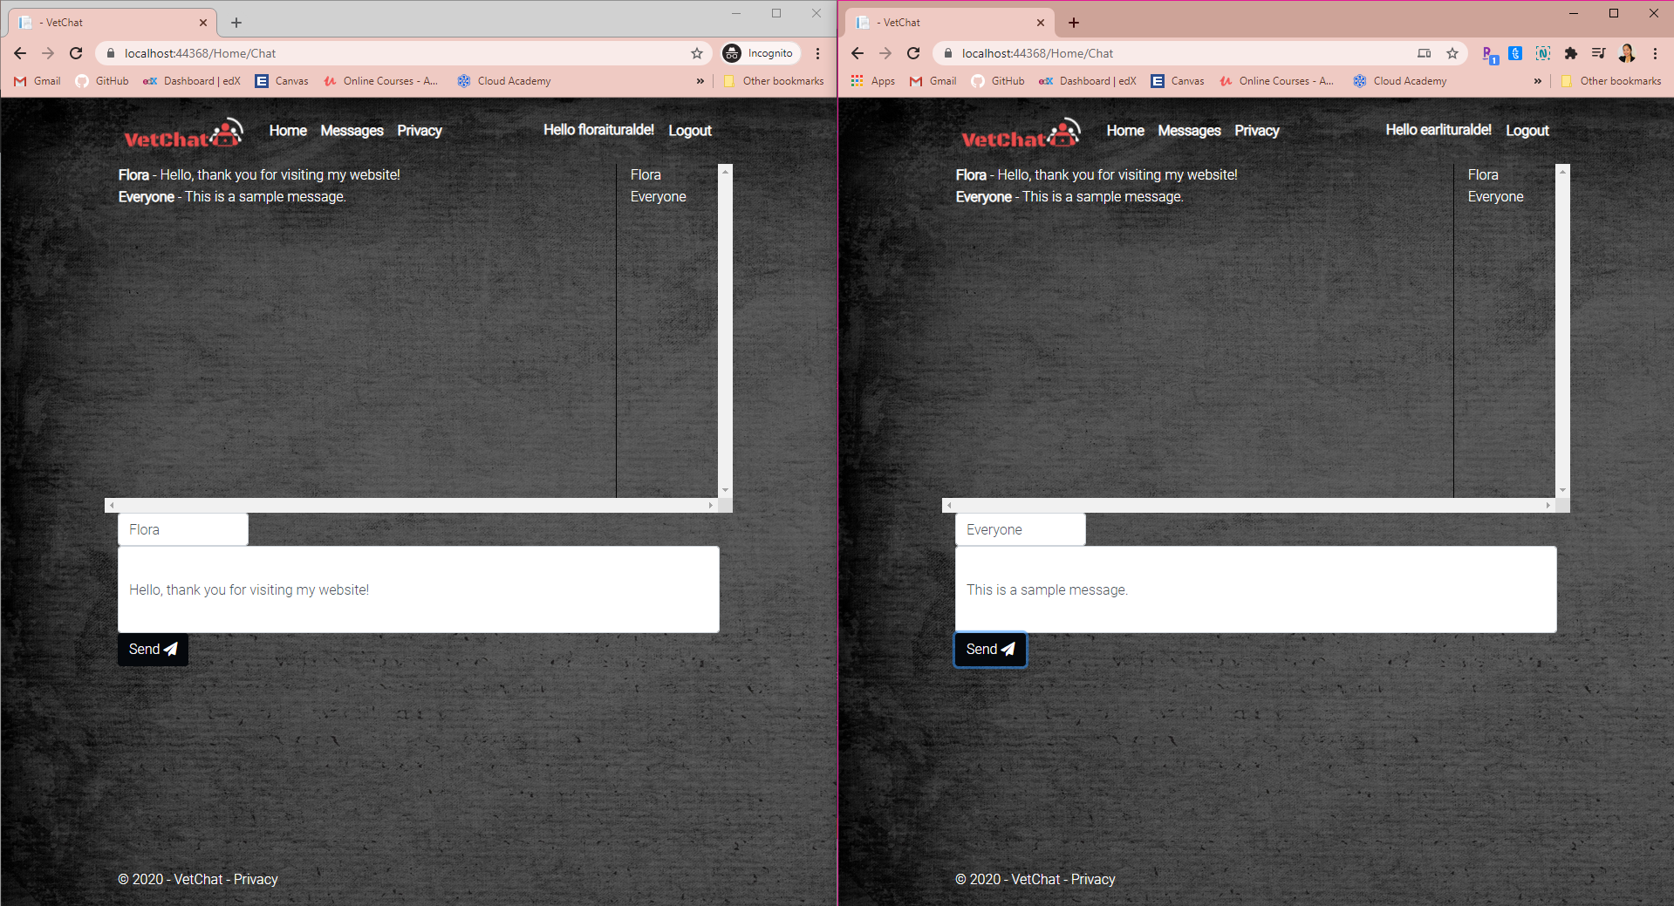
What does my project Include?
SignalR
- ASP.NET SignalR is a library for ASP.NET developers that simplifies the process of adding real-time web functionality to applications. Real-time web functionality is the ability to have server code push content to connected clients instantly as it becomes available, rather than having the server wait for a client to request new data.
- SignalR handles connection management automatically, and lets you broadcast messages to all connected clients simultaneously, like a chat room. You can also send messages to specific clients. The connection between the client and server is persistent, unlike a classic HTTP connection, which is re-established for each communication.

Slide 6
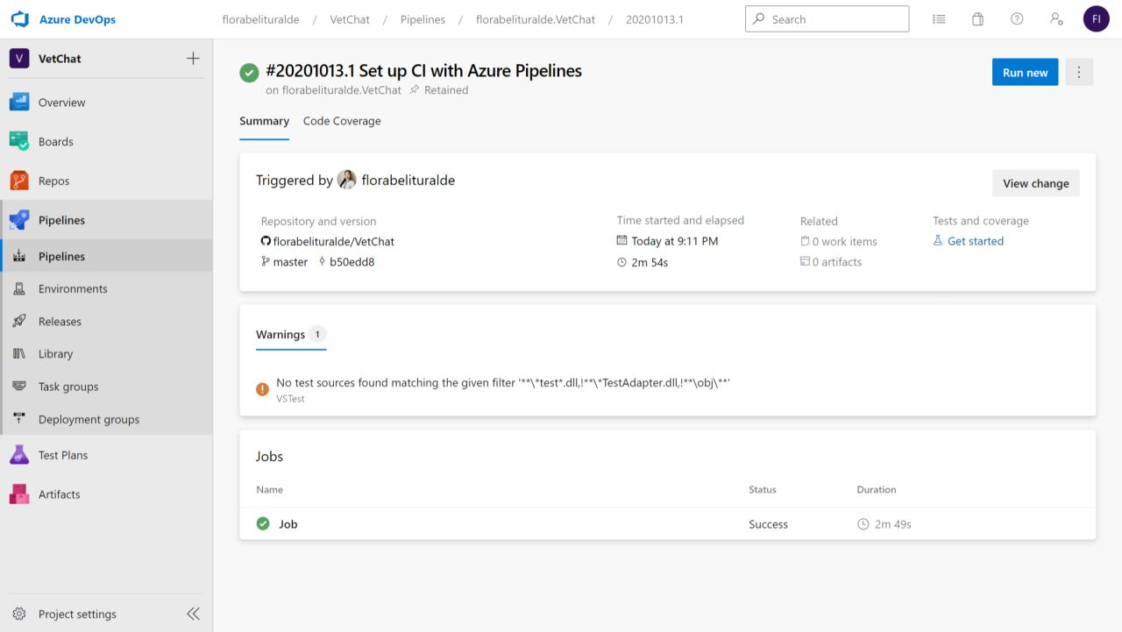
What does my project Include?
Azure DevOps (CI/CD)
- Continuous integration is a software development practice in which developers merge code changes frequently into the main code branch. Continuous integration employs automated testing, which runs every time new code is committed so the code in the main branch is always stable.
- Continuous delivery is the frequent, automated deployment of new application versions into a production environment. By automating the steps required for deployment, teams reduce issues that may occur upon deployment and enable more frequent updates.

Slide 7

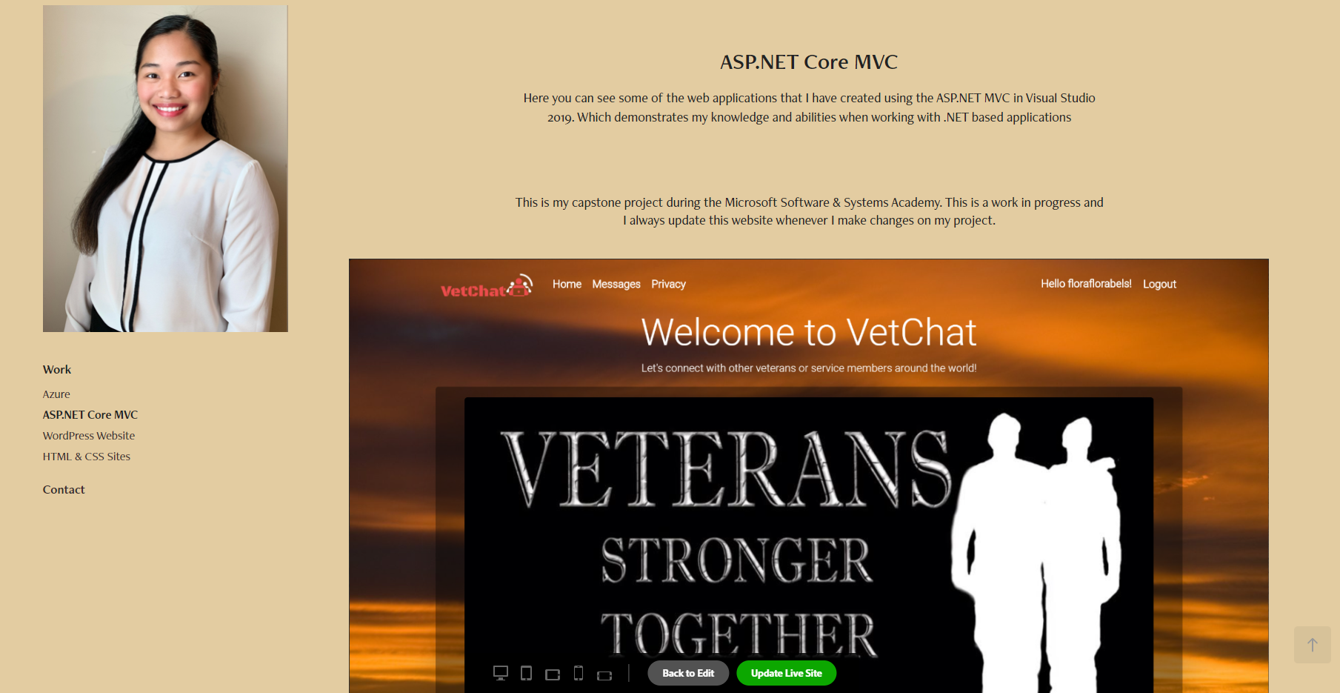
Portfolio Website
You can also view this capstone project in my portfolio here: https://portfolio.adobe.com/ddf31684-54ec-4bd0-b075-035159d51a26/preview/aspnet-core-mvc

Slide 8
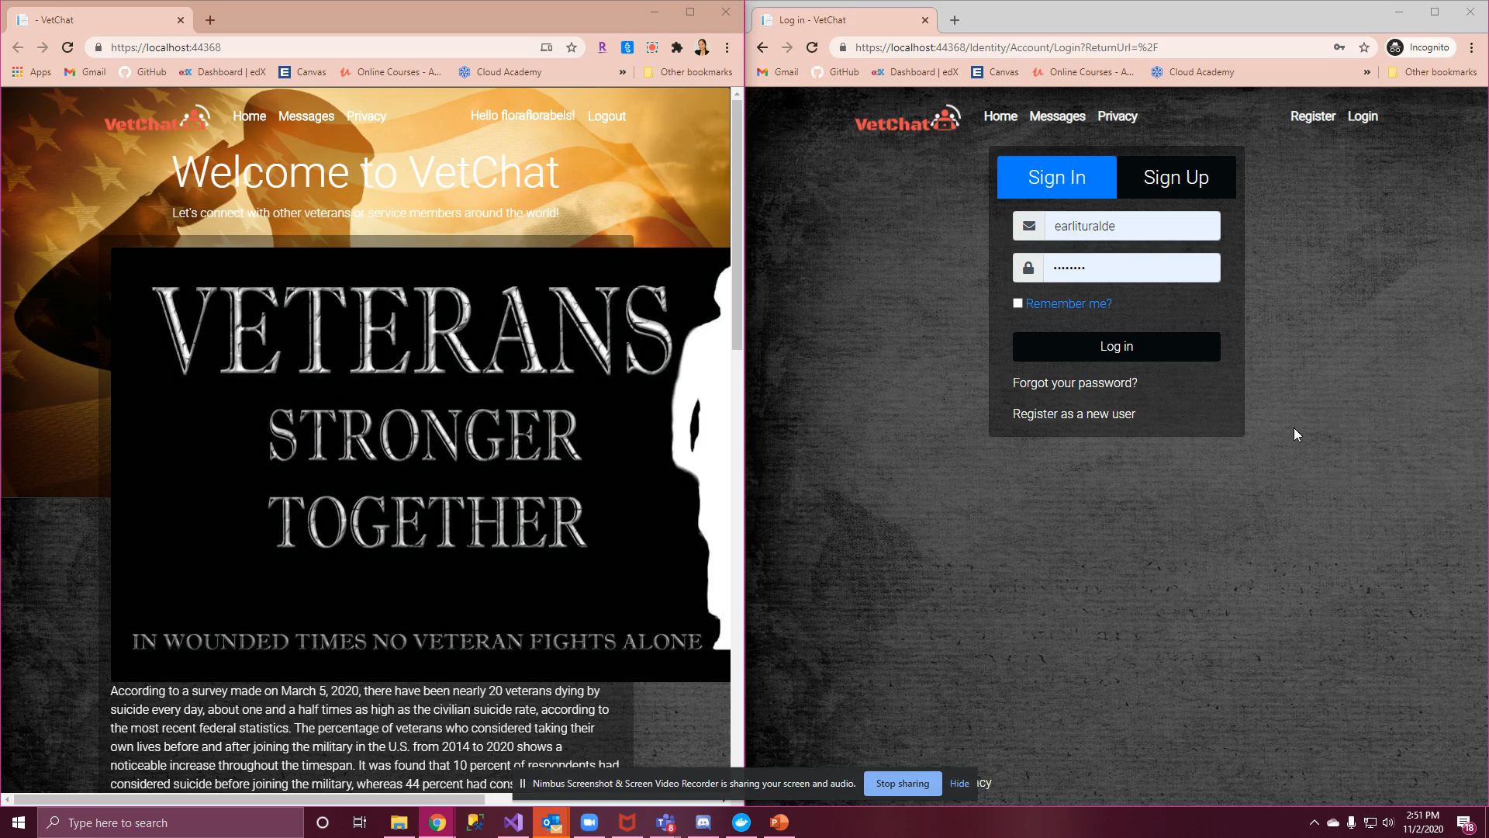
Video Sample of the Project

